Slide 1


Secure ECU Communication Using Post-Quantum Cryptography
From the Quantum Threat to Real-Time Implementation on STM32
Author: Ghaith Ben Brahim
Context: Engineering End-of-Study Internship
Date: February 2026
ACTIA
Notes:
Good morning, everyone. Today, I'm excited to share the progress on my internship project: securing ECU communication using post-quantum cryptography. This project addresses a critical, emerging threat to automotive security. We're moving beyond theoretical discussions to real-time implementation on STM32 microcontrollers. This work is vital for the future of connected vehicles.

Slide 2



Project Brief
What Was Given
What Was Decided
Implement UART and CAN communication between ECUs (STM32H7 and STM32G4)
Focus on Post-Quantum Cryptography (PQC) — the practical answer to the quantum threat
Simulate noisy transmission channels to mimic quantum errors
Real CAN-FD communication (not just simulation)
NIST-standardized algorithms: ML-KEM, ML-DSA, FN-DSA
Integrate STM32 cryptographic libraries
End goal: UDS 0x29 Authentication Flow
Explore quantum-inspired secure communication
Notes:
Our project brief initially explored simulating noisy quantum channels, but we quickly pivoted to a more pressing engineering challenge. We decided to focus on Post-Quantum Cryptography, or PQC, because it's the practical answer to the quantum threat for embedded systems. This means real CAN-FD communication, using NIST-standardized algorithms, with the ultimate goal of demonstrating a secure over-the-air firmware update. This shift ensures our work directly addresses current industry needs, moving from abstract simulation to tangible, secure solutions. We're building a demonstrator that will be directly applicable to ACTIA's product lines. Now, let's look at how we'll cover this journey today.

Slide 3







Presentation Outline
01
02
Quantum vs Post-Quantum Cryptography
The Quantum Computing Threat
03
Why QKD (BB84) Cannot Be Used in Automotive
04
The PQC Algorithms Chosen
05
Current Progress: First Results on STM32H7
06
Next Steps & Full Project Roadmap
Notes:
Here's a quick overview of what we'll cover today. We'll start by establishing the urgent threat posed by quantum computing. Then, we'll differentiate between quantum and post-quantum cryptography, explaining why PQC is our focus. We'll also dive into the specific PQC algorithms we've chosen and share our initial benchmark results on the STM32H7. Finally, I'll outline the next steps and the full project roadmap. This structure will provide a clear understanding of the problem, our solution, and the path forward. Let's begin by understanding the quantum threat itself.

Slide 4

Why Quantum Computers Break Today's Security
Today's Classical Security
The Quantum Threat
Mathematical Foundations
Destructive Algorithms
RSA: Factoring large integers (e.g., 2048-bit numbers)
Shor's Algorithm (1994): Breaks RSA and ECDSA in polynomial time — from billions of years to hours.
ECDSA: Elliptic curve discrete logarithm problem
Complexity
Grover's Algorithm (1996): Cuts symmetric key security in half (AES-128 becomes effectively AES-64).
Requires billions of years for classical supercomputers to solve via brute force or known attacks.
~4,000 Logical Qubits
The threshold to break RSA-2048 in just a few hours.
Notes:
The core message here is simple: today's encryption methods are fundamentally vulnerable to quantum computers. Our current security, like RSA and ECDSA, relies on mathematical problems that take classical computers billions of years to solve. However, quantum computers, with algorithms like Shor's, can break these in mere hours. Even symmetric keys, like AES-128, see their security cut in half by Grover's algorithm. This isn't a distant problem; a quantum computer with about 4,000 logical qubits could break RSA-2048 in just a few hours. This means our current cryptographic backbone is at risk. So, when does this become a real concern for us?

Slide 5



DEEPER DIVE: HOW QUANTUM ALGORITHMS THREATEN CLASSICAL CRYPTOGRAPHY
SHOR'S ALGORITHM
GROVER'S ALGORITHM
HNDL THREAT
Asymmetric Vulnerability
Symmetric Weakening
Harvest Now, Decrypt Later
Efficiently solves integer factorization and discrete logarithms in polynomial time.
Provides a quadratic speedup for brute-force attacks, effectively halving security bits.
Attackers are recording encrypted traffic TODAY to decrypt it once quantum hardware matures.
RSA (Factoring)
AES-128 → AES-64
Public keys can derive private keys, rendering RSA encryption and signatures OBSOLETE.
Requires doubling key lengths (e.g., moving to AES-256) to maintain security.
Automotive Impact
Long-lived ECUs (10-15 years) are particularly vulnerable to retrospective decryption.
Hash Functions
ECC / ECDSA
Speeds up pre-image and collision attacks, impacting integrity checks and digital signatures.
Breaks the elliptic curve discrete logarithm problem (ECDLP), compromising modern PKI.
Immediate Action
Transitioning to PQC is an urgent necessity to protect data with long-term sensitivity.

Slide 6
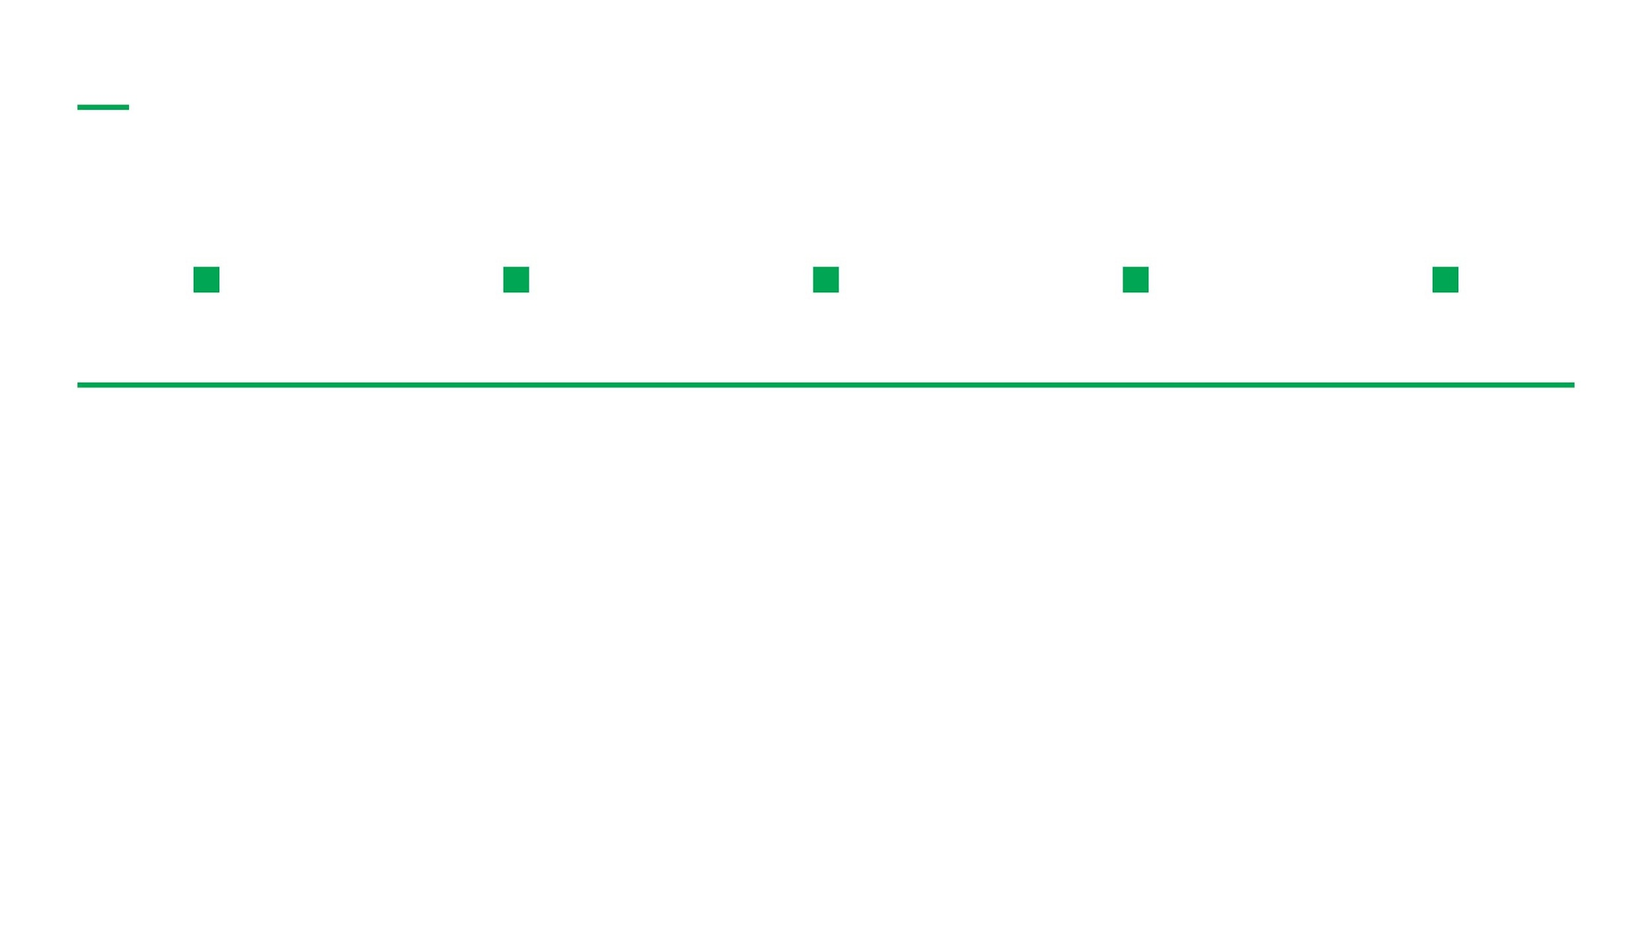

The Timeline: When Does This Become Real?
2024
2027
2030
2035
2040+
IBM Condor: 1,000+ physical qubits. Research stage. Cannot break RSA yet.
Estimated: Error-corrected qubits emerging. First practical demonstrations.
NSA, ETSI, BSI: Estimated risk window begins for sensitive systems.
Automotive: Systems sold TODAY will still be on roads — and at risk.
HNDL: Attackers already recording encrypted traffic for future decryption.
HNDL Attack: Harvest Now, Decrypt Later
Nation-state actors record encrypted CAN/V2X traffic today — planning to decrypt it once quantum computers are ready. The threat is NOW, not later.
2024 | ACTIA TEMPLATE | 5
ACTIA
Notes:
The timeline shows this threat is not theoretical; it's imminent. While IBM's current quantum computers are still in the research stage, error-corrected qubits are expected to emerge by 2027. By 2030, major security agencies like the NSA anticipate the risk window for sensitive systems will begin. Crucially for us, vehicles sold today will still be on the roads in 2035 and beyond, directly in this risk window. This is compounded by the 'Harvest Now, Decrypt Later' attack, where adversaries are already collecting encrypted data, waiting for quantum computers to decrypt it. The threat is here now, not in some distant future. This urgency drives our focus on practical solutions.

Slide 7



Two Responses to the Quantum Threat
Quantum Key Distribution (QKD)
Post-Quantum Cryptography (PQC)
Based on quantum physics principles
Based on hard mathematical problems
Uses quantum states (photons) to share secret keys
Runs on classical hardware (CPU, MCU)
Security guaranteed by laws of physics
Resistant to quantum computer attacks
Interception causes state collapse (detected)
NIST standardized in 2024 (FIPS 203, 204, 206)
Example: BB84 protocol (1984)
Examples: ML-KEM, ML-DSA, Falcon
Status: Works in labs & short fiber links
Status: READY FOR DEPLOYMENT NOW
This project focuses on PQC — the only practical solution for embedded automotive systems.
Notes:
As we established the urgency of the quantum threat, we now look at the two main responses: Quantum Key Distribution and Post-Quantum Cryptography. QKD relies on quantum physics for security, using photons to share keys, but it is primarily a lab-based solution. PQC, on the other hand, uses complex mathematical problems that even quantum computers cannot solve efficiently. This allows it to run on classical hardware, like our STM32 microcontrollers. PQC is standardized by NIST and is ready for immediate deployment, making it the practical choice for embedded automotive systems. Let's dive deeper into how QKD works to understand its limitations.

Slide 8






How BB84 Works
STEP 1
STEP 2
STEP 3
STEP 4
Alice Sends Photons
Bob Measures
Basis Reconciliation
Eavesdropping Detection
•
Encodes bits as photon polarizations
•
Randomly chooses a basis to measure each photon
•
Compare bases over classical channel (not bits)
•
Eve's measurement disturbs the quantum state
•
Uses random bases: Rectilinear (+) or Diagonal (×)
•
Same basis = Correct bit
•
Keep bits where bases matched
•
Different basis = 50% error rate
•
Introduces detectable error rate
•
Result: Shared secret key
•
States: 0°, 45°, 90°, or 135°
•
High error = Abort transmission
"Security guaranteed by Heisenberg's Uncertainty Principle — you cannot measure a quantum state without disturbing it."
Notes:
To fully appreciate why PQC is our focus, it helps to understand the elegance of QKD, specifically the BB84 protocol. Alice encodes bits as photon polarizations, using random bases. Bob then measures these photons, also choosing random bases. They then publicly compare their chosen bases, keeping only the bits where their bases matched. The brilliance here is that any attempt by an eavesdropper to measure the photons will disturb their quantum state, introducing detectable errors. This guarantees security through the laws of physics. However, this impressive theoretical security comes with significant practical challenges, especially for automotive applications.

Slide 9






BB84 is Brilliant — But Impossible in a Car
Fiber Optic Infrastructure
Distance Limitations
QKD requires dedicated quantum channels (fiber or line-of-sight). ECUs communicate via CAN bus — a robust electrical bus. No photon transmission possible.
Current QKD: max 100-200 km over fiber. In-vehicle ECUs are 30 cm apart, but V2X/backend requires satellite relay or quantum repeaters — not yet practical.
Hardware Requirements
Real-Time Constraints
Cost and Integration
Requires single-photon emitters, detectors, and cryogenic components. None of this fits in an automotive ECU.
Automotive ECUs need 1-10 ms response. QKD key generation is slow (seconds to minutes). CAN bus doesn't support photon protocols.
QKD hardware costs $10k-$100k+ per node. An ECU costs $5-$50. Mass production is economically impossible.
QKD is physically and economically incompatible with automotive ECUs. PQC is the answer.
Notes:
While BB84 is brilliant, it is fundamentally incompatible with the automotive environment. First, QKD requires dedicated fiber optic or line-of-sight channels; our ECUs communicate over electrical CAN bus. Second, current QKD systems have distance limitations, and while ECUs are close, V2X or backend communication would require impractical quantum repeaters. Third, the hardware for QKD involves single-photon emitters and cryogenic components, which simply do not fit into an ECU. Finally, QKD key generation is slow, taking seconds to minutes, which violates the hard real-time constraints of automotive systems. These physical and economic barriers make QKD impossible for in-vehicle use. This is why Post-Quantum Cryptography is the only viable path forward.

Slide 10



Post-Quantum Cryptography: The Practical Solution
Mathematical problems so hard that even quantum computers cannot solve them efficiently. Based on lattice problems, hash functions, and error-correcting codes.
Lattice-Based
Hash-Based
Code-Based
Based on the Learning With Errors (LWE) problem. Finding a short vector in a high-dimensional lattice is hard even for quantum computers.
Based on one-way hash functions — already quantum-resistant by design. Conservative, well-understood security.
Based on error-correcting codes (McEliece, 1978). Long history of security analysis and resistance to quantum attacks.
Algorithms: SLH-DSA (SPHINCS+)
Algorithms: HQC (NIST Selected)
Algorithms: ML-KEM, ML-DSA, FN-DSA (Falcon)
NIST 2024 Standardization Complete — FIPS 203 (ML-KEM), FIPS 204 (ML-DSA), FIPS 206 (FN-DSA)
Notes:
Post-Quantum Cryptography, or PQC, offers the practical solution we need. It relies on mathematical problems so complex that even quantum computers cannot solve them efficiently. These algorithms run on standard classical hardware, like the STM32 microcontrollers we are using. NIST has recently completed its standardization process for several PQC algorithms, which fall into three main families. Lattice-based algorithms, like ML-KEM and ML-DSA, are based on the Learning With Errors problem. Hash-based algorithms, such as SPHINCS+, leverage one-way hash functions. And code-based algorithms, like HQC, use error-correcting codes. The NIST standardization means these algorithms are rigorously vetted and ready for deployment. We've selected specific algorithms from these families for this project.

Slide 11
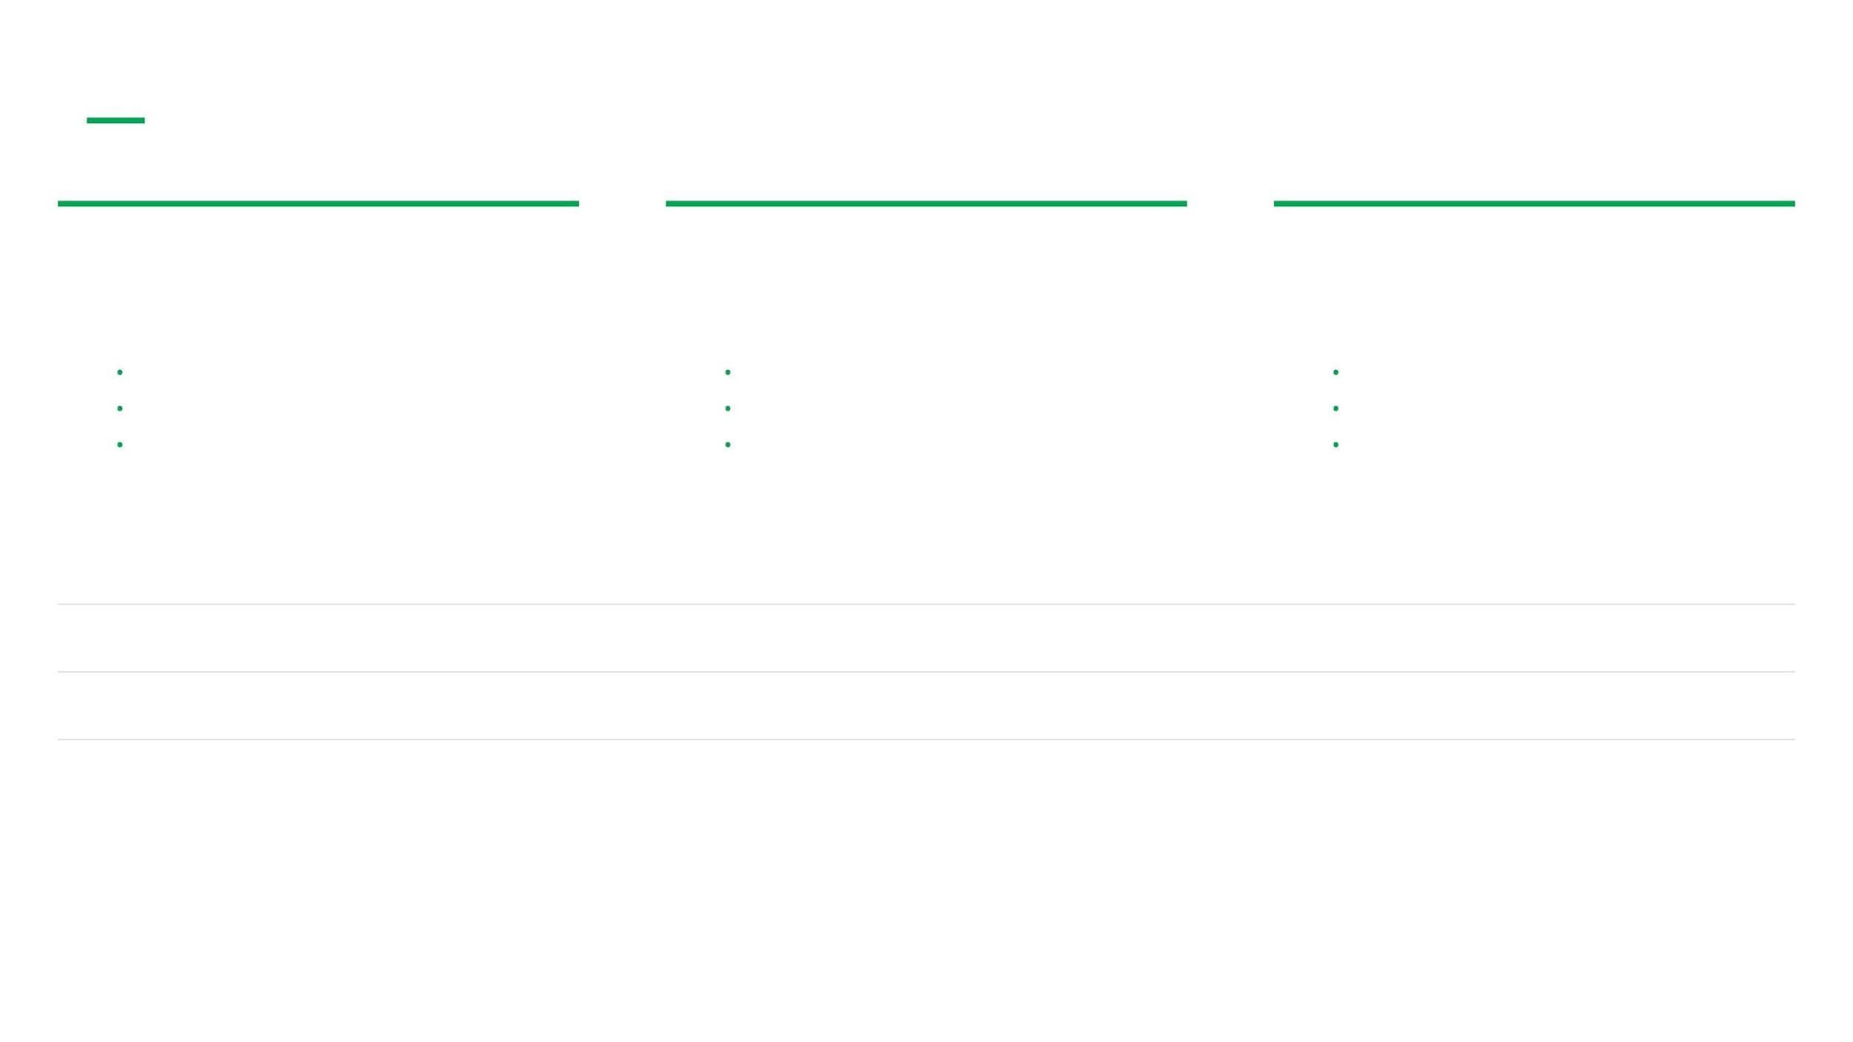



Algorithm Selection for This Project
ML-KEM
ML-DSA
FN-DSA
FIPS 203 | CRYSTALS-Kyber
FIPS 204 | CRYSTALS-Dilithium
FIPS 206 | Falcon
Role:
Key Exchange
Role:
Digital Signatures
Role:
Digital Signatures
•
Fastest KEM in NIST portfolio
•
Fast signing and verification
•
Smallest signatures (666B)
•
Compact keys and ciphertext
•
Balanced size vs performance
•
Fastest verification (~11 ms)
•
Security: Module-LWE
•
Security: Module-SIS
•
Security: NTRU Lattice
Metric
ML-KEM-768
ML-DSA-2
Falcon-512
Security Level
NIST-3
NIST-2
NIST-1
Key/Sig Size
1184B (Public Key)
2420B (Signature)
666B (Signature)
Primary Role
Key Exchange
Authentication
Fast Verification
Notes:
For this project, we've selected three NIST-standardized algorithms: ML-KEM, ML-DSA, and Falcon. ML-KEM, formerly Kyber, is our choice for key exchange. It's the fastest Key Encapsulation Mechanism in the NIST portfolio, offering compact keys and ciphertext, which is ideal for establishing session keys over CAN-FD. For digital signatures, we're using ML-DSA, formerly Dilithium, and Falcon. ML-DSA provides fast signing and verification with a good balance of signature size and performance. Falcon, on the other hand, stands out for its extremely small signatures and incredibly fast verification times, which is critical for applications like OTA firmware updates where the backend signs once, and the ECU verifies quickly. These selections provide a robust and efficient cryptographic suite for our secure communication prototype.

Slide 12


First Results: Benchmarks on STM32H7B3I @ 280 MHz
Exceeding Published State-of-the-Art Results
STM32H7 outperforms AURIX TC397 (300 MHz) — with just cache optimization, no internal RAM
needed
ML-KEM Variant
Keygen (ms)
Encaps (ms)
Decaps (ms)
1.84
2.42
2.51
ML-KEM-512
3.12
4.08
4.15
ML-KEM-768
4.85
6.24
6.38
ML-KEM-1024
IAV Paper (AURIX TC397 @ 300 MHz):
ML-KEM-768 keygen = 5.1 ms / encaps = 6.7 ms / decaps = 6.8 ms
ARM Cortex-M7 @ 280 MHz | I-Cache + D-Cache enabled
-O2 optimization | PQCleanAutomotive library
Notes:
We've selected our algorithms, and now we're seeing the first concrete results from our benchmarks on the STM32H7. The key takeaway here is that the STM32H7 is performing exceptionally well, even exceeding published results from more specialized automotive MCUs. Our initial ML-KEM benchmarks show that the STM32H7, running at 280 MHz with just cache optimization, is faster than the AURIX TC397 at 300 MHz. For example, ML-KEM-768 key generation is 3.12 milliseconds on our setup, compared to 5.1 milliseconds in the IAV paper. This is a significant performance advantage, and it means we can achieve real-time PQC on a cost-effective platform. We're running with standard -O3 optimization and the PQCleanAutomotive library, proving the STM32H7's capability. This strong performance sets us up for the next phase of deep optimization.

Slide 13




CURRENT PROGRESS: AUTOMOTIVE TRANSPORT LAYER & ISO-TP
THE CHALLENGE
THE SOLUTION
PQC certificates often exceed 4 KB, far surpassing the 8-byte payload limit of standard CAN frames. This requires a robust transport layer for extended data payloads.
Developed a custom ISO-TP (ISO 15765-2) library specifically for CAN-FD to handle extended 32-bit payloads and ensure reliable PQC data transmission.
Multi-frame Messaging
Flow Control
Error Handling
Implements efficient segmentation and reassembly of large data packets across multiple CAN-FD frames.
Manages data flow between sender and receiver to prevent buffer overflows and ensure synchronization.
Incorporates mechanisms for detecting and recovering from transmission errors or timeouts.
VALIDATION: Successfully tested library's ability to transport large PQC data across a live CAN-FD network.

Slide 14
CURRENT PROGRESS: CLASSICAL CRYPTOGRAPHY BASELINE
OBJECTIVE
AES-256-GCM
PASS
SHA-256
PASS
Establish a validated classical baseline using mbedTLS to serve as a reference for the UDS 0x29 service before PQC integration.
HMAC-SHA256
PASS
HKDF
PASS
ECC (P-256)
PASS
ECDH
PASS
OUTCOME
ECDSA
PASS
X.509 Parsing
PASS
Confirmed a robust foundation, ensuring that the system's state transitions and memory limits are well-understood. Ready for hybrid PQC implementation.
> Initializing mbedTLS stack... [OK] > Running cryptographic self-tests... [OK] > Validating NIST P-256 curve operations... [OK] > Parsing DER-encoded certificates... [OK] > All classical primitives verified on STM32H7.

Slide 15
UDS 0X29 AUTHENTICATION FLOW: ISO 14229-1:2020 PKI
[ VCI CLIENT ]
[ ECU SERVER ]
0x01: Initiation Sends cert_client (~588B) + challenge_client (32B)
Request: [29 01] + Cert + Challenge
Prerequisites ECU has cert_ca
Processing Waiting for server challenge
Response: [69 01] + Challenge_S + PubKey_S
Verification Validates cert_client & generates challenge_server
0x03: Proof Signs challenge_S & sends PubKey_C
Request: [29 03] + Signature + PubKey_C
Derivation Generates ephemeral keypair
Finalization Derives session_key via HKDF
Response: [69 03] + Success
Access Granted Verifies signature & derives session_key
AUTHENTICATED SESSION ESTABLISHED: Subsequent messages encrypted with AES-256-GCM

Slide 16

Next Phase: Algorithm Theory & Optimization
YOU ARE HERE
Week 1
Week 2
Week 3
Week 4
ML-KEM (Kyber) Theory & Optimization
ML-DSA & Falcon Theory & Benchmarking
Optimization & Algorithm Selection
Benchmark Report & Milestone
Polynomial ring mathematics: R_q = Z_q[X]/(X^256 + 1)
Module-LWE signatures vs NTRU lattices
Full ITCM/DTCM optimization for algorithms
Publication-quality benchmark report
Comparison to state-of-art (IAV, PQM4)
Number Theoretic Transform (NTT) optimization
Falcon's FFT-based approach & floating-point
Complete benchmark matrix (key variants)
Milestone presentation to supervisor
ITCM/DTCM memory placement for speedup
Signature size impact on CAN-FD frames
Final selection document
2024 | ACTIA TEMPLATE | 12
ACTIA
Notes:
Building on these promising initial benchmarks, our next phase focuses on deep algorithm theory and optimization. This isn't just about running code; it's about understanding the mathematical underpinnings to extract maximum performance. In Week 1, we'll dive into ML-KEM's polynomial ring mathematics and specifically target the Number Theoretic Transform, which accounts for 70-80% of the runtime. We'll also implement ITCM/DTCM memory placement, expecting a 2-3x speedup. Then, in Week 2, we'll tackle ML-DSA and Falcon, comparing their lattice structures and Falcon's unique FFT-based approach. We'll also analyze how signature size impacts CAN-FD frame counts. This detailed theoretical work will directly inform our optimization strategy, leading us to a complete benchmark matrix and final algorithm selection.

Slide 17




Full Project Roadmap
IN PROGRESS
Phase 1
Phase 2
Phase 3
Phase 4
Benchmarking & Optimization
Protocol Implementation
UDS 0x29 Authentication Flow
GUI & Finalization
Algorithm analysis & selection
CAN-FD communication
UDS 0x29 Authentication design
TouchGFX interface design
STM32H7 performance study
ISO-TP fragmentation
End-to-end PQC integration
Thesis documentation
Benchmark report
PQC over CAN bus
Full service demonstrator
Final defense
Notes:
This detailed optimization work fits into the larger project roadmap, providing a clear path from research to a deployable solution. We're currently in Phase 1, focused on benchmarking and optimization, which will culminate in a comprehensive benchmark report. Following this, Phase 2 will involve implementing the communication protocols, specifically CAN-FD between the STM32H7 and STM32G4, including ISO-TP fragmentation for larger PQC messages. Phase 3 is where we integrate PQC into a secure OTA firmware update application, using ML-KEM for key exchange and Falcon for signatures. Finally, Phase 4 will bring it all together with a TouchGFX GUI and the final thesis documentation. This structured approach ensures we deliver a robust and practical PQC solution for automotive ECUs.

Slide 18



Summary & Contribution
The Threat is Real and Urgent
PQC is the Practical Answer
STM32H7 Delivers Performance
Quantum computers will break RSA and ECDSA. Automotive systems with 10-15 year lifetimes are already in the risk window. HNDL attacks make the threat present, not future.
QKD is physically impossible on CAN-bus connected ECUs. NIST-standardized PQC (ML-KEM, ML-DSA, Falcon) runs on existing STM32 hardware with acceptable performance overhead.
Initial benchmarks show STM32H7 outperforms dedicated automotive MCUs from published literature — enabling real-time PQC for automotive OTA updates.
Next milestone: Complete optimization study and produce benchmark report → Algorithm selection for OTA application layer.
2024 | ACTIA TEMPLATE | 14
ACTIA
Notes:
In summary, this project addresses a critical and urgent threat: quantum computers will break today's encryption, putting automotive systems at risk. Vehicles sold today will be on the road for 10-15 years, directly in the quantum risk window, and 'Harvest Now, Decrypt Later' attacks are already happening. Post-Quantum Cryptography is the only practical answer for embedded automotive systems. QKD is simply not feasible for CAN-bus connected ECUs due to its physical and cost limitations. Our initial benchmarks on the STM32H7 demonstrate its surprising performance, outperforming even dedicated automotive MCUs in published literature. This means we can achieve real-time PQC for critical functions like OTA updates on a standard, cost-effective platform. Our next milestone is to complete the optimization study and produce a detailed benchmark report, which will guide our final algorithm selection for the OTA application layer.

Slide 19





Thank You — Questions?
Thank You!
Key References
NIST FIPS 203/204/206 (2024): The official standards for ML-KEM, ML-DSA, and FN-DSA.
Ghaith Ben Brahim
IAV Paper (2024): "Crypto-Agility in Automotive Real-Time Systems" — Benchmarks on AURIX TC397.
PQ-CAN Paper (2025): arXiv 2504.10730 — Secure communication protocols for CAN bus.
ghaith.benbrahim@insat.ucar.tn
https://github.com/GhaithhBenbrahim
PQCleanAutomotive: Optimized PQC library for embedded automotive platforms.
Engineering End-of-Study Internship 2026
Notes:
Thank you for your time and attention. I hope this presentation has clarified the urgency of the quantum threat and the practical steps we're taking to address it with PQC on STM32. I'm confident that our approach provides a robust and forward-looking solution for secure automotive communication. I'm happy to answer any questions you might have about the project, the algorithms, or our benchmark results.

